Slide 1
Learning and Development (L&D) Management Application
Shanmukh Shekar K C

Slide 2
TABLE OF CONTENTS
Introduction
Problem Statement
Motivation
Objectives
Framework/Methodology
Results

Slide 3
Introduction
Purpose: The Learning and Development (LGD) Management Application simplifies managing training programs through a centralized platform for efficiency and continuous learning.
Significance: It supports effective employee growth and organizational competitiveness by addressing key learning and development needs.
Users: The application is designed for account managers, L&D teams (admins), and employees, with specific tools for each role.
Functions: It allows training requests, program management, course completion, and feedback collection to streamline the learning process.
Features: Key functions include course creation, employee engagement tracking, and detailed reporting to address training challenges in large organizations.

Slide 4
Problem Statement
Difficulty in coordinating training requests between account managers and the Learning and Development (L&D) team.
Limited visibility into employee participation and course completion.
Inefficient methods for creating, managing, and updating training programs.
Lack of actionable insights and reporting to evaluate the effectiveness of learning initiatives.
Poor employee engagement and feedback mechanisms for continuous improvement

Slide 5
Motivation
The motivation for this project stems from the need to address inefficiencies in managing training programs within large organizations. By centralizing processes, enhancing accountability, and fostering continuous learning, the Learning and Development (L&D) Management Application empowers organizations to improve employee growth, engagement, and competitiveness in an increasingly dynamic workplace.

Slide 6
Objectives
The L&D Management Application is a web-based platform designed to streamline training and development management in large organizations.
Key Objectives:
Simplify training requests and management.
Enable course creation, assignment, and tracking.
Provide employees with a user-friendly platform for learning and feedback.

Slide 7
Framework/ Methodology
Implemented secure authentication and role-based access control for three user types: Account Managers, Admins, and Employees. Features: User registration and login. Secure token-based authentication (JWT). Role-based access control: Admins: Manage courses and track progress. Managers: Submit training requests. Employees: Access and complete courses.

Slide 8
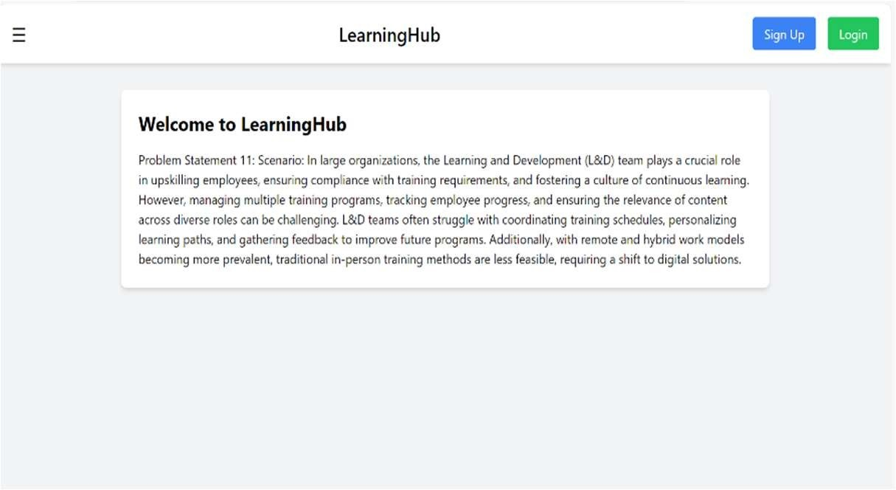
Results

Slide 9
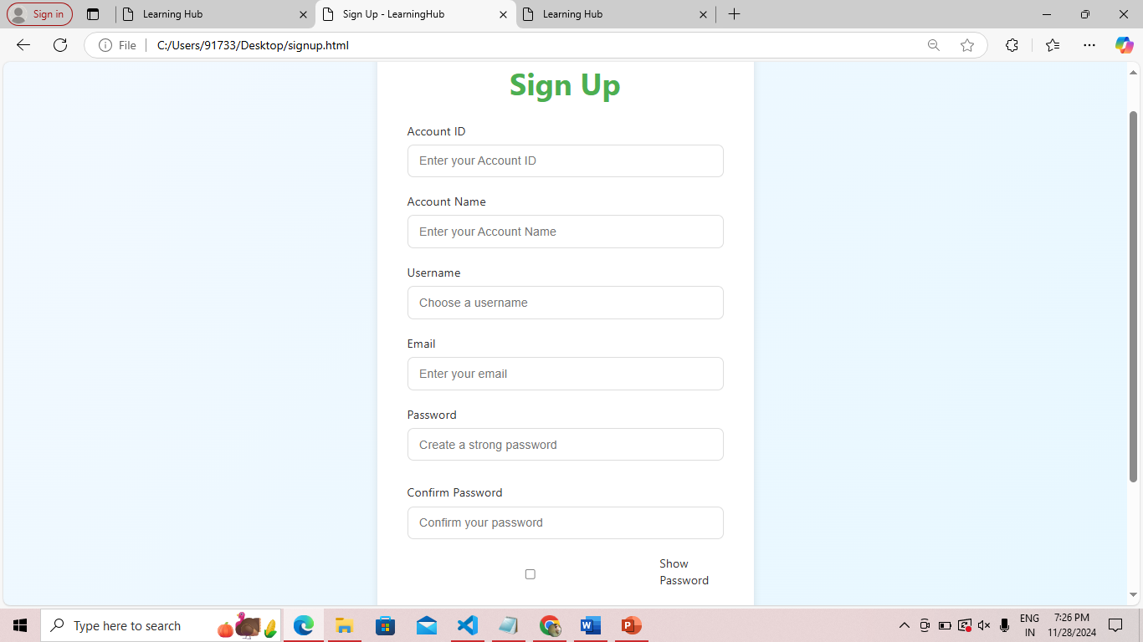
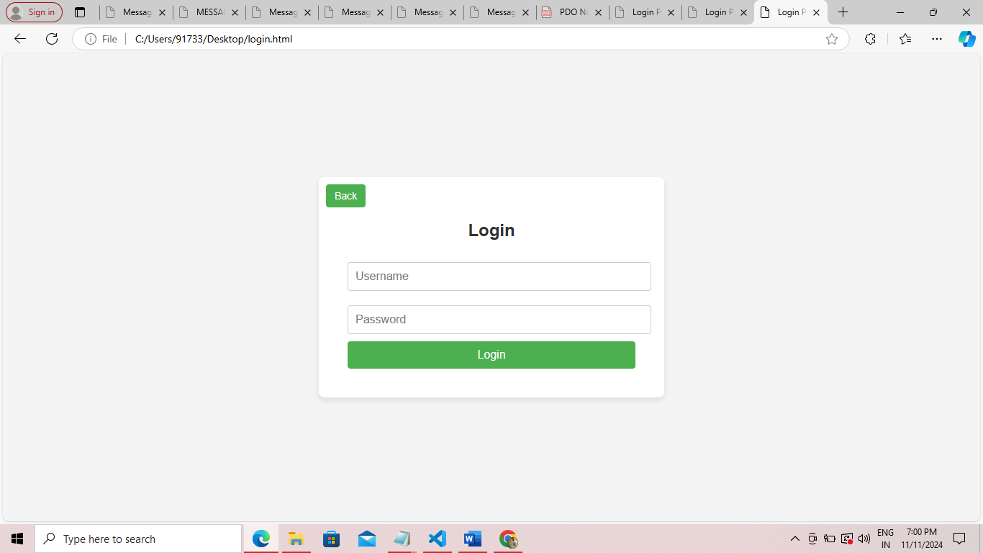
Signup and Login Page

Slide 10
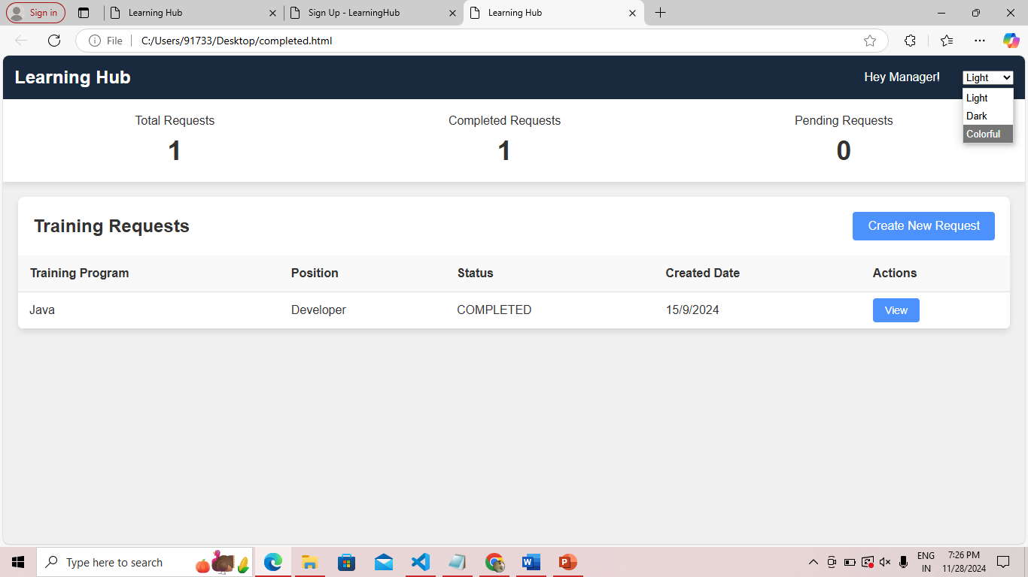
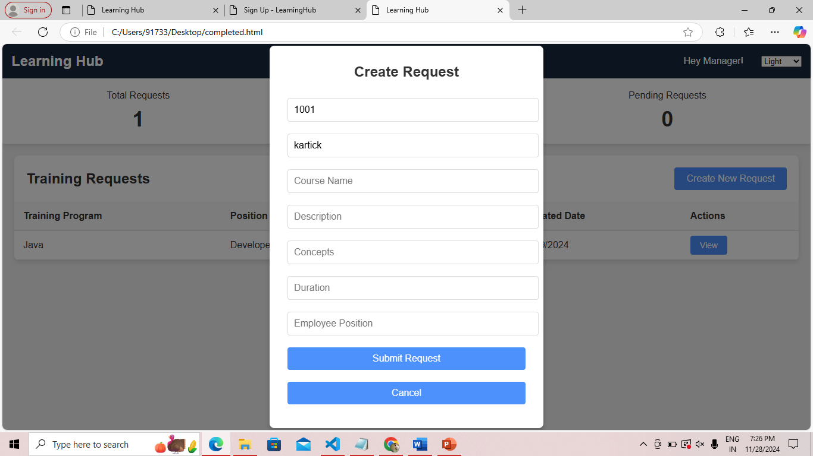
Manager Dashboard and Create Request

Slide 11
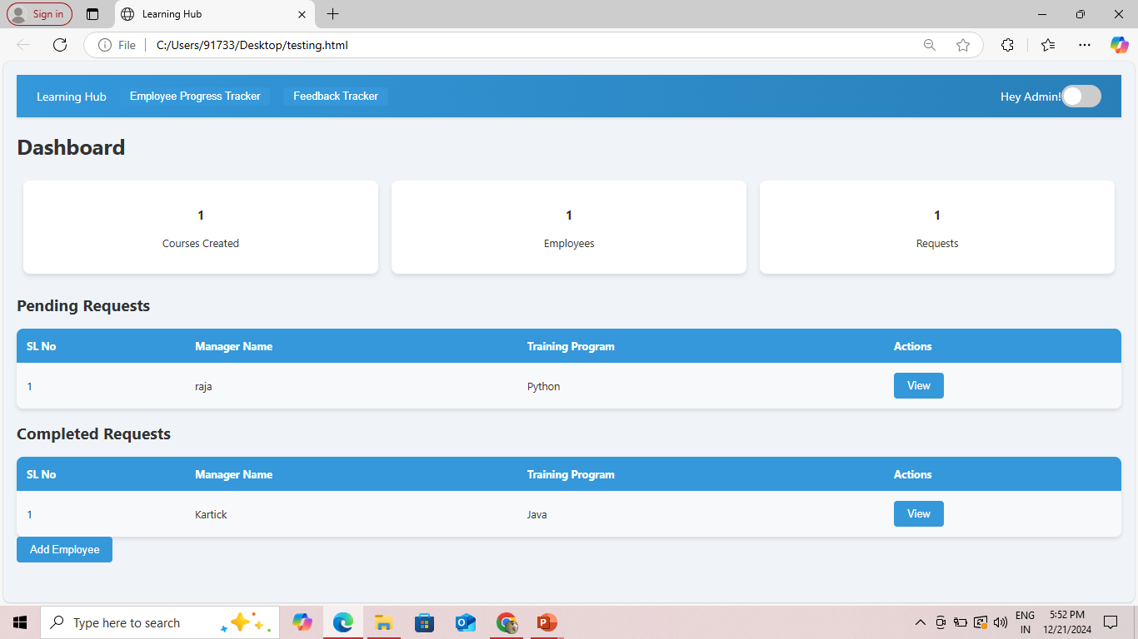
Admin Dashboard

Slide 12
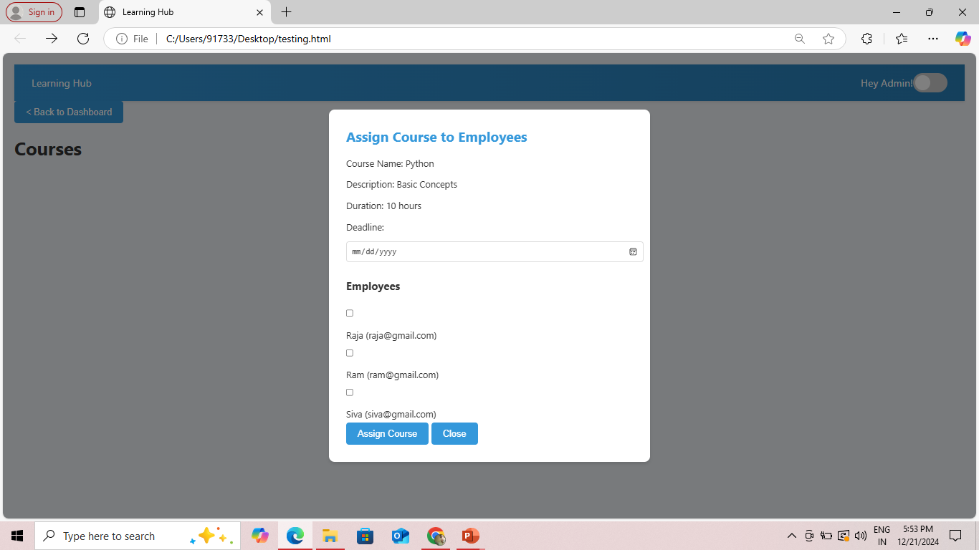
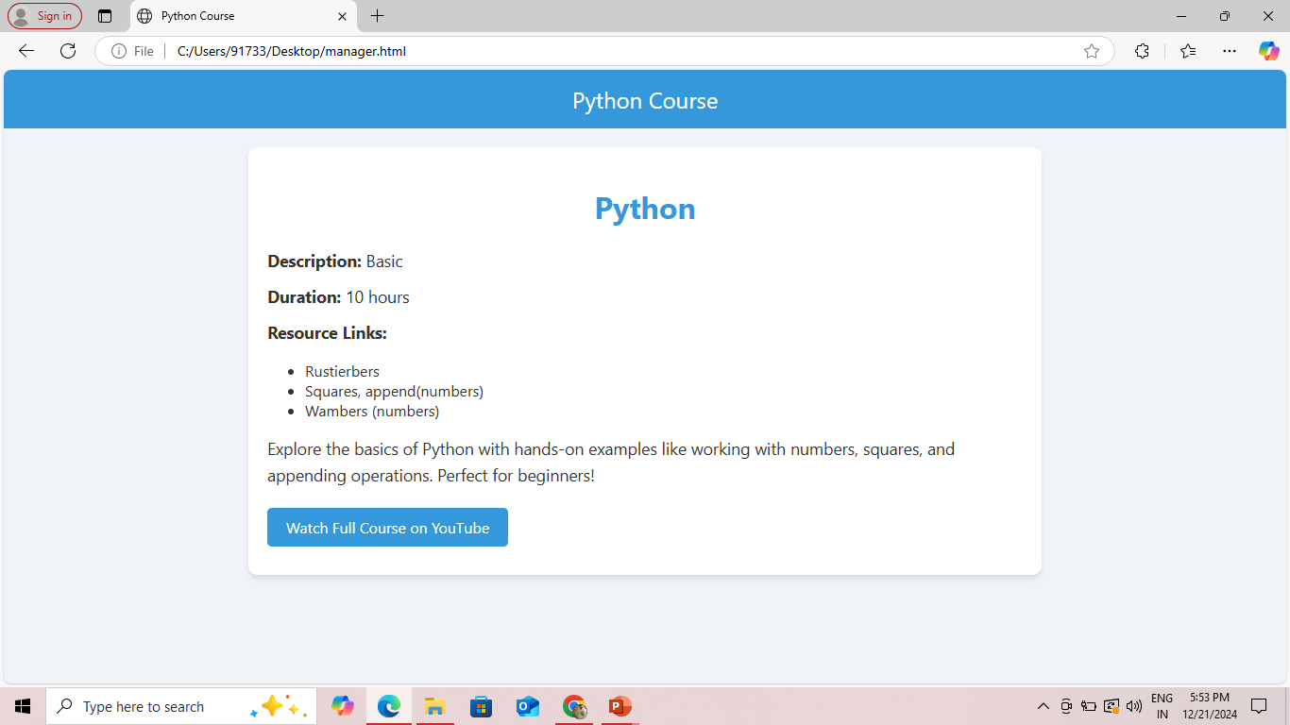
Assign Course To Employee

Slide 13
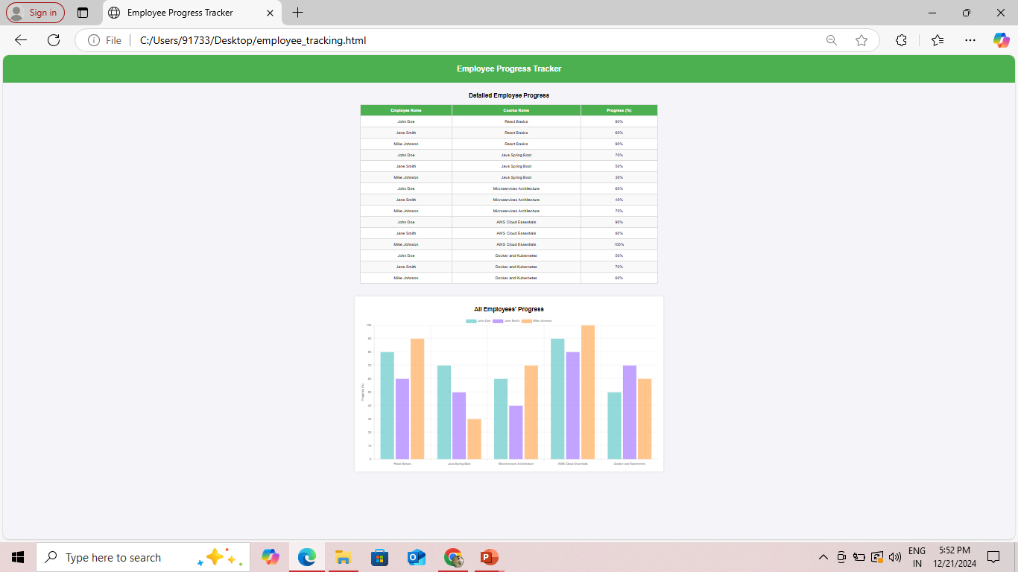
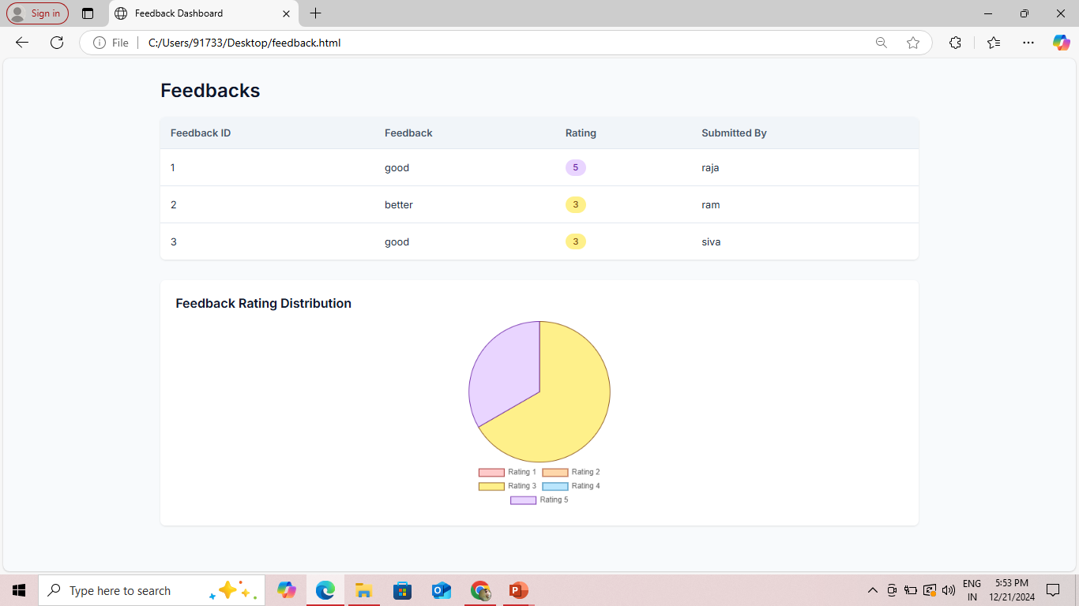
Employee Progress Tracker and Feedback Tracker

Slide 14
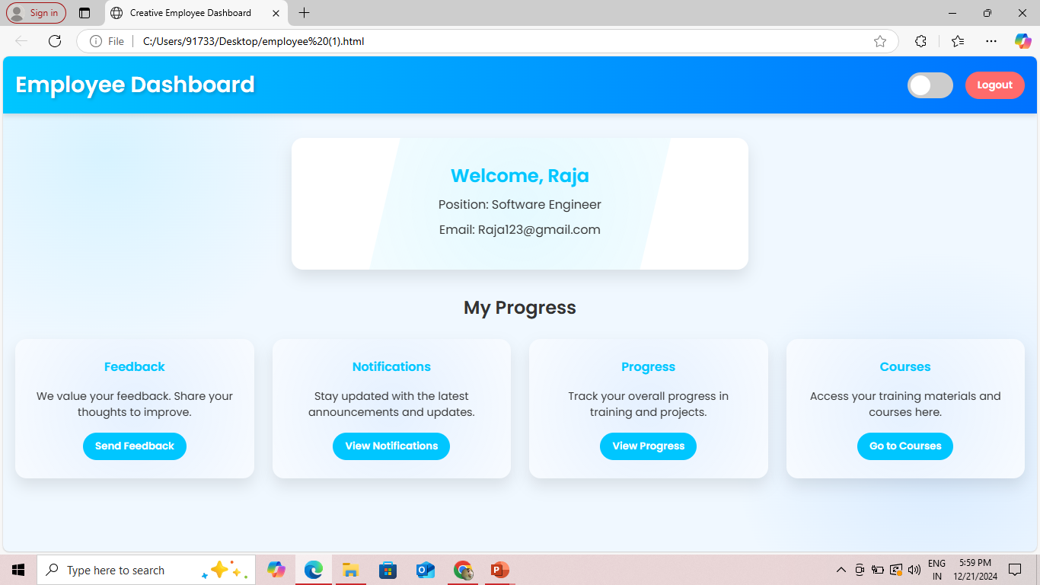
Employee Dashboard

Slide 15
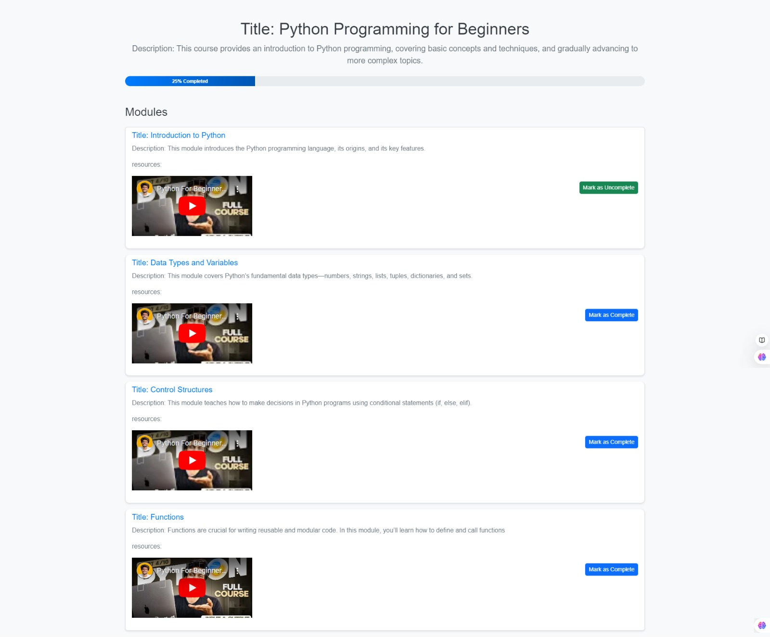
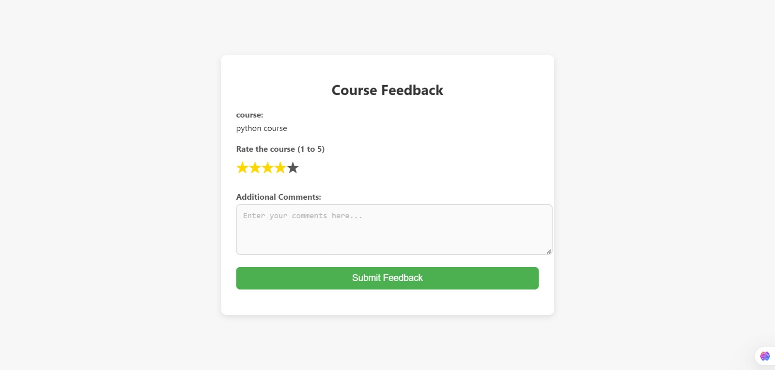
Course Progress and Course feedback

Slide 16
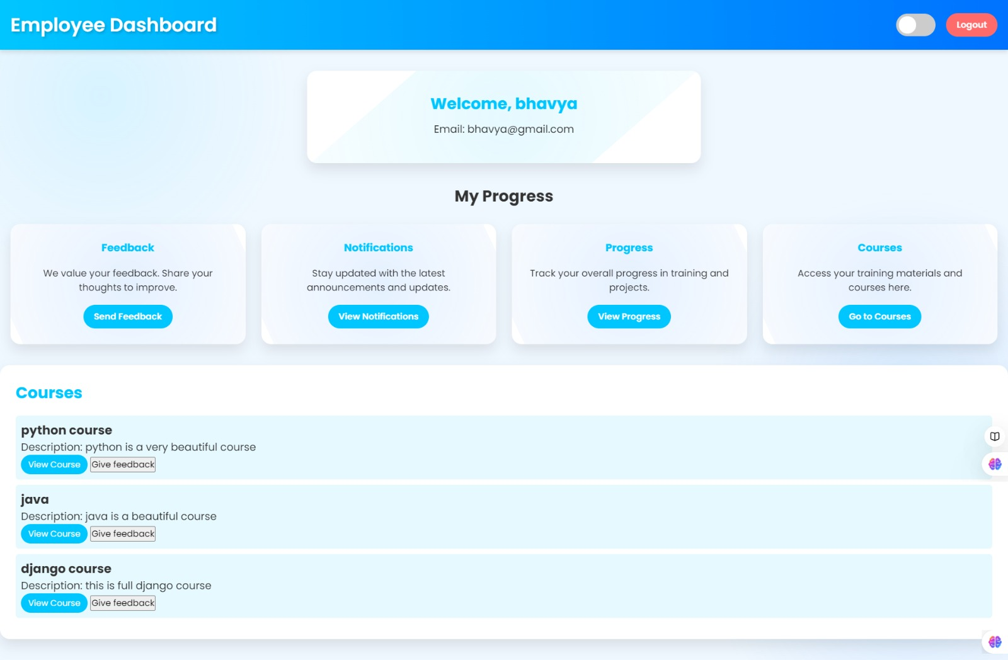
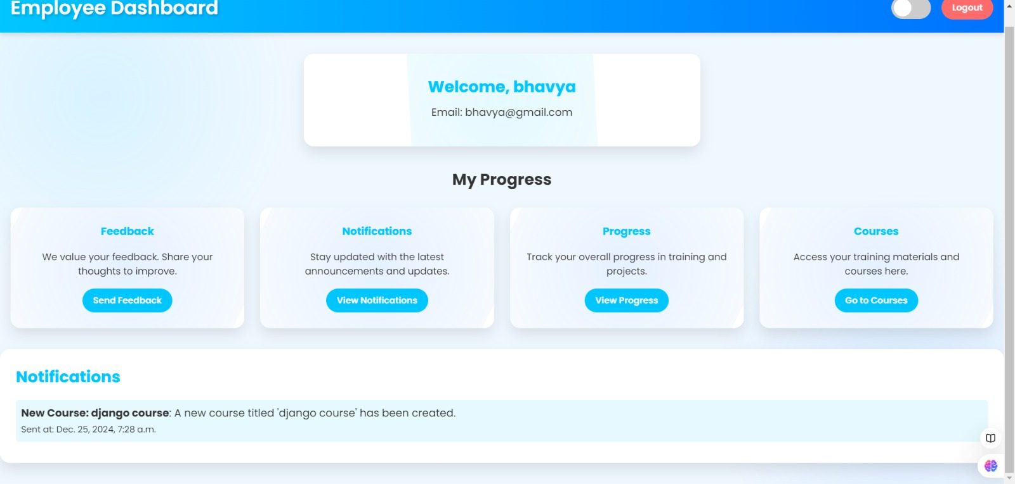
Courses and Notifications

Slide 17
Milestones
Milestone 1 Evaluation (Week 3): User Authentication and Role Management are fully implemented. Training Request Management functionalities are working with rolebased access. Milestone 2 Evaluation (Week 6): Course Creation and Assignment functionalities are operational. Employee Progress Tracking is integrated, with course completion statistics visible. Milestone 3 Evaluation (Week 9): Feedback Collection is implemented, and feedback is stored for reporting. Dashboard Overview displays a snapshot of key metrics for L&D admin users. Milestone 4 Evaluation (Week 10): Notification System for automated alerts is fully Course Progress Analytics is integrated, with graphical insights for tracking learning effectiveness.

Slide 18
THANK YOU

